Slide 1
Components for multicopter
Ruslan Kotvytskyi

Slide 2
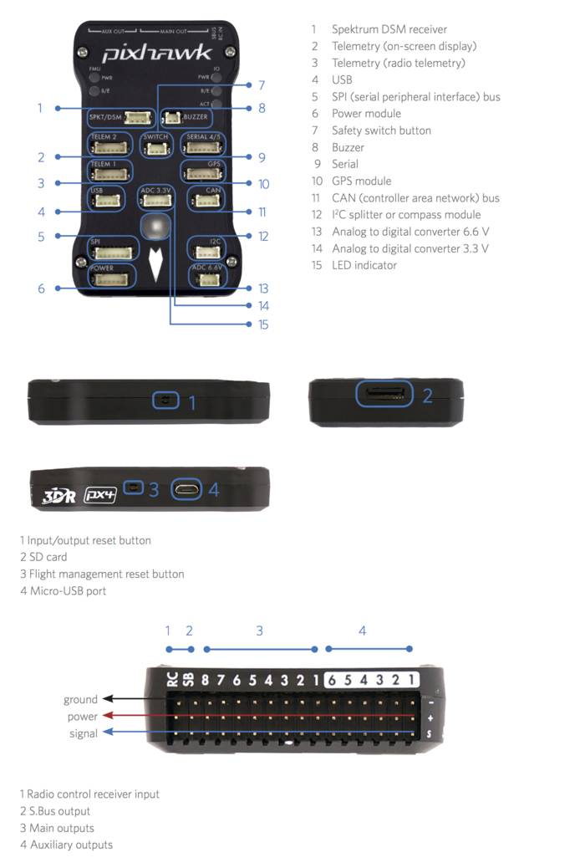
AutoPilot System (university)
Pixhawk1 = 250€ (included GPS/Compass, Buzzer, power module)
Specifications
Processor
32-bit ARM Cortex M4 core with FPU
168 Mhz/256 KB RAM/2 MB Flash
32-bit failsafe co-processor
Sensors
MPU6000 as main accel and gyro
ST Micro 16-bit gyroscope
ST Micro 14-bit accelerometer/compass (magnetometer)
MEAS barometer
Power
Ideal diode controller with automatic failover
Servo rail high-power (7 V) and high-current ready
All peripheral outputs over-current protected, all inputs ESD protected
Interfaces
5x UART serial ports, 1 high-power capable, 2 with HW flow control
Spektrum DSM/DSM2/DSM-X Satellite input
Futaba S.BUS input (output not yet implemented)
PPM sum signal
RSSI (PWM or voltage) input
I2C, SPI, 2x CAN, USB
3.3V and 6.6V ADC inputs
Dimensions
Weight 38 g (1.3 oz)
Width 50 mm (2.0”)
Height 15.5 mm (.6”)
Length 81.5 mm (3.2”)
https://synosystems.de/de/3dr-pixhawk-und-zubehor/85-3dr-pixhawk.html?search_query=pixhawk&results=43

Slide 3
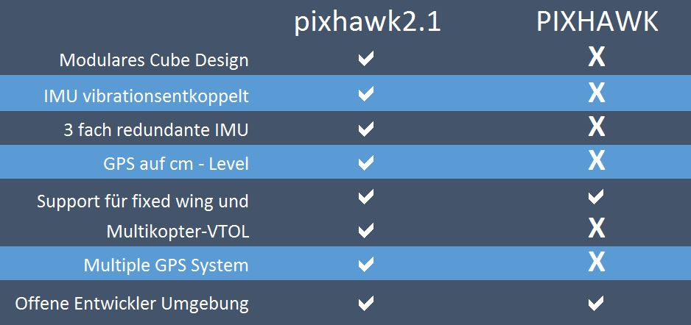
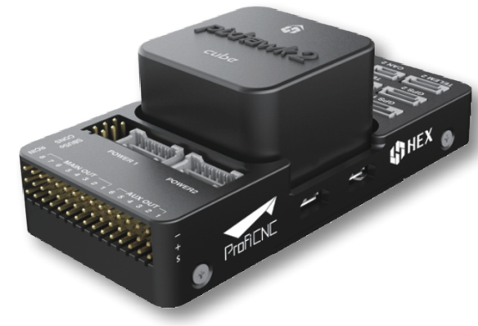

Slide 4
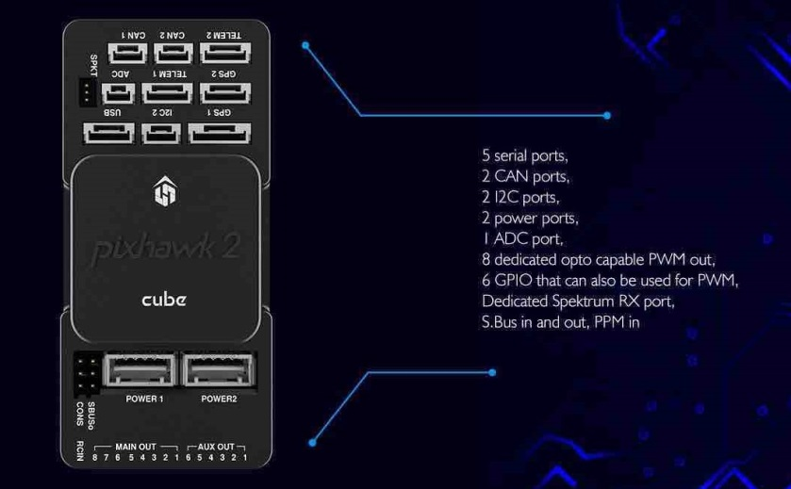
AutoPilot System
Pixhawk2.1 = 240€ (+69 € GPS/Compass)
Specifications
Processor
32-bit ARM Cortex M4 core with FPU
168 Mhz/256 KB RAM/2 MB Flash
32-bit failsafe co-processor
Sensors
Three redundant IMUs (accels, gyros and compass)
InvenSense MPU9250, ICM20948 and/or ICM20648 as first and third IMU (accel and gyro)
ST Micro L3GD20+LSM303D or InvenSense ICM2076xx as backup IMU (accel and gyro)
Two redundant MS5611 barometers
Power
Redundant power supply with automatic failover
Servo rail high-power (7 V) and high-current ready
All peripheral outputs over-current protected, all inputs ESD protected
Interfaces
14x PWM servo outputs (8 from IO, 6 from FMU)
S.Bus servo output
R/C inputs for CPPM, Spektrum / DSM and S.Bus
Analogue / PWM RSSI input
5x general purpose serial ports, 2 with full flow control
2x I2C ports
SPI port (un-buffered, for short cables only not recommended for use)
2x CAN Bus interface
3x Analogue inputs (3.3V and 6.6V)
High-powered piezo buzzer driver (on expansion board)
High-power RGB LED (I2C driver compatible connected externally only)
Safety switch / LED
https://synosystems.de/de/pixhawk2/335-pixhawk21-suite-standard-aka-the-cube.html

Slide 5
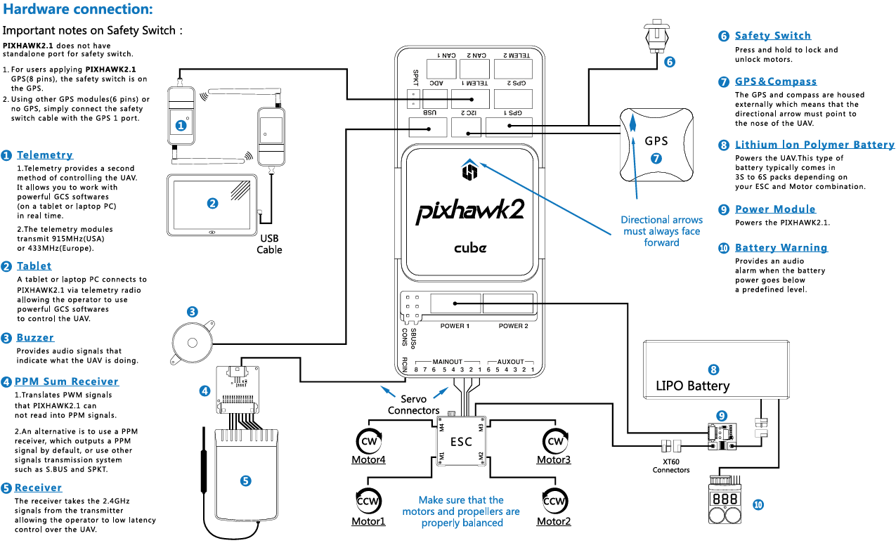
General structure of drone

Slide 6
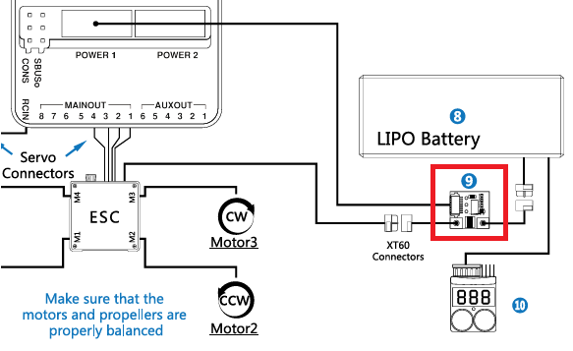
Power module
30€
This power module can be used instead of the original for the APM and Pixhawk AutoPiloten. It is suitable for use up to 7s LiPo and contains a compatible current sensor.
Max. Input voltage: 30V
Output: 5.3V, max. 3A
Sensormess range up to 90A
Current and voltage measurement designed for 5V ADCs
Weight incl. Cable and plug: 27 g
Dimensions: 25 x 21 x 9 mm

Slide 7
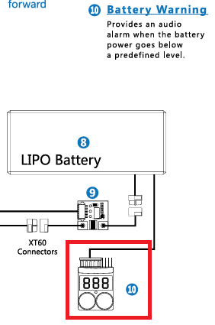
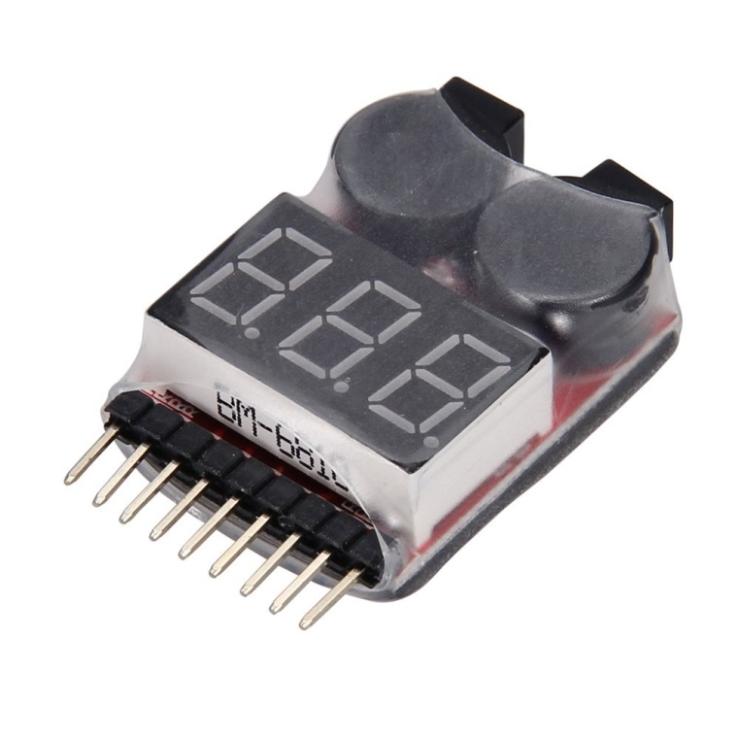
Battery Tester
1-8S Lipo LiMn Battery Tester Low Voltage Buzzer Alarm
10€

Slide 8
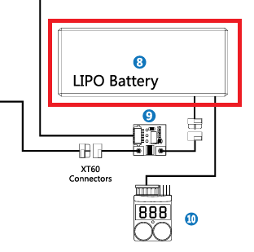
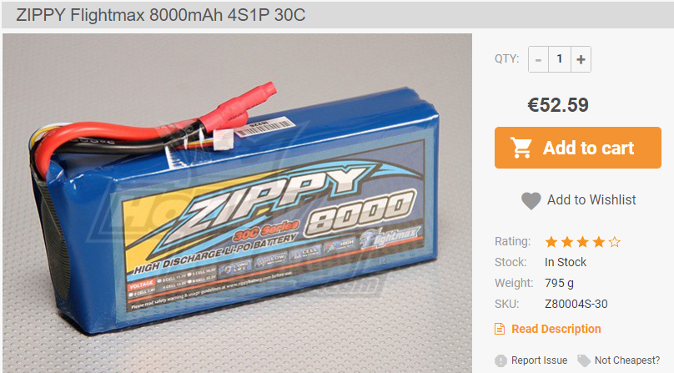
Battery
lipo 4S turnigy 8000 mah 20-30 C

Slide 9
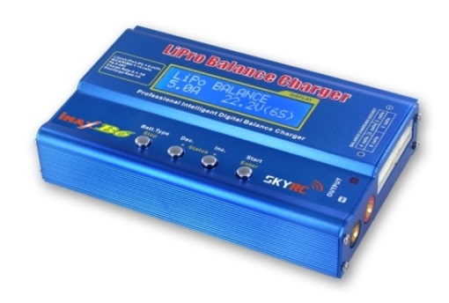
Battery Charger Balancer Adapter
imax-b6 30 €

Slide 10
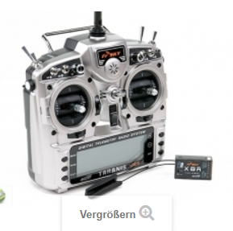
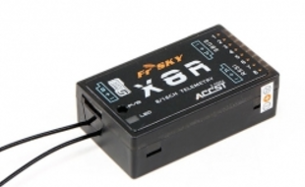
RC-SENDER UND SETS
180-230 €
FrSky 2.4GHz ACCST TARANIS X9D PLUS und X8R Combo

Slide 11
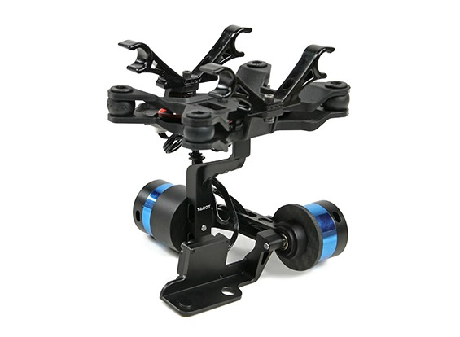
€62.19
Specs:
Working Voltage: DC 7.4V ~ 14.8V (Recommended 12V, three lithium battery)
Working current: 200mA-500mA (power supply voltage and the motor related)
Working temperature: -15c ~ 65c
Processor: Dual 32-bit high-speed ARM core processor
Sensor: Three rotor MEMS gyroscope rotor MEMS accelerometers
Maximum angular rate: 2000 ° / Sec
Motor drive frequency: 20KHz (no noise smoothing drive)
Control accuracy: 0.1
Control angle range: -45Deg ~ 45Deg (roll), -135 ° ~ 90 ° (tilt)
Includes:
ZYX3 rotor gyro USB cable group × 1
Xiaomi Yi Sports Camera two-axis gyro sensor head × 1
Xiaomi Yi Sports Camera two-axis gyro head master controller × 1
USB computer interface x 1
T-2D gimbal with motors and isolated mounting
ZYX22 brushless gimbal controller
Related hardware and interface cables

Slide 12
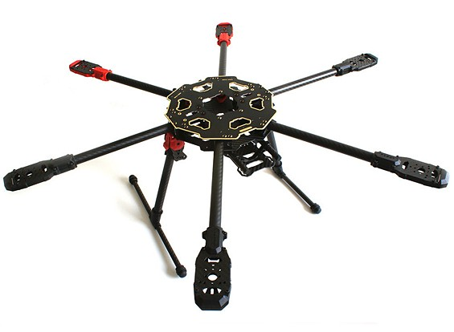
Frame
€99.49
Features:
• Fold-ability for transportation and storage
• 3K carbon construction
• Gold plated PCB connections
• Lightweight
Specs:
Size motor to motor: 685mm
Weight: 780g
Height from ground to lower rods: 180mm
Height from ground to top: 220mm

Slide 13
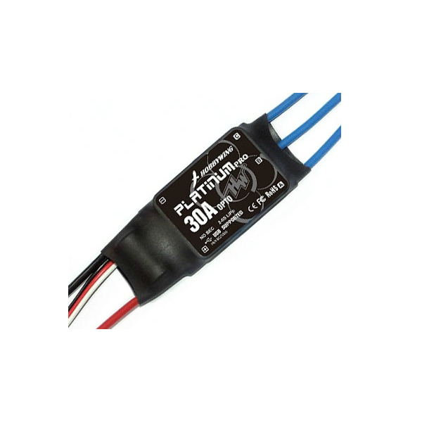
Electronic speed control
ESC(2-6s).
1.1 Output: Continuous 30A, burst 40A up to 10 seconds.
1.2 Input Voltage: 2-6 cells lithium battery or 5-18 cells NiMH battery.
1.3 BEC: Not available.
1.4 Refresh rate of the throttle signal: 50Hz to 432Hz.
1.5 Control Signal Transmission: Optical/electrical coupled system.
1.6 Max Speed: 210000rpm for 2 Poles BLM, 70000rpm for 6 poles BLM, 35000rpm for 12 poles BLM.
(BLM = BrushLess Motor)
1.7 Size: 55mm (L) * 25mm (W) * 12mm (H).
1.8 Weight: 31g.
€12

Slide 14
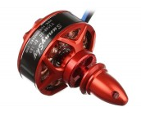
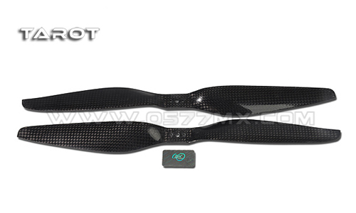
Motor
SunnySky V3508-20 KV580 €30
Specifications
- Model:V3508 580KV
- KV: 580 RPM/V
- Weight: 107g (including 600mm silicone wires)
- Diameter of Shaft: 3.17mm
- Stator Diameter: 35mm
- Stator Length: 8mm
- Motor silicone wire: 600mm
1255 Carbon Propellers
€10 CW+CCW

Slide 15
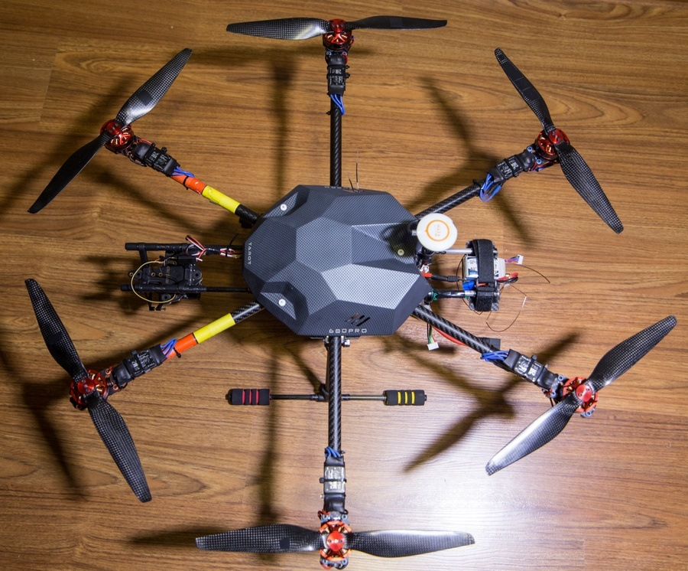
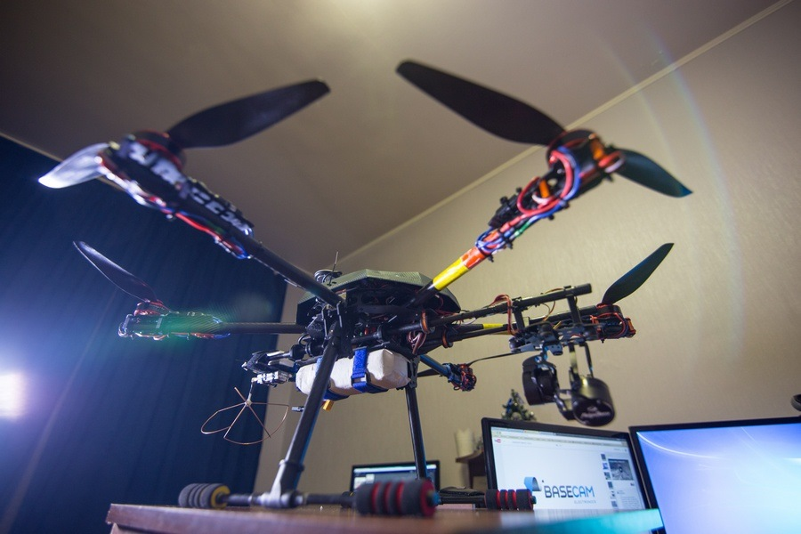

Slide 16
(240 + 70 + 30 + 10 + 50 + 30 + 230) + 65 + (12 + 30 + 12)*6 + 100 = 660 + 65 + 324 + 100 = 1150 €
Or 660 + 65 + (12 + 30 + 12)*4 +70 = 660 + 65 +216 + 70 = 1011 €

